Slide 1
Chapter 3 & 6
VE216 Mid2 Review

Slide 2

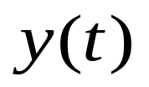

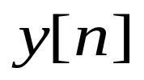
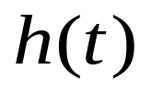

Chapter 3: Fourier Series
Why FS?
  tedious calculation for convolution

Slide 3
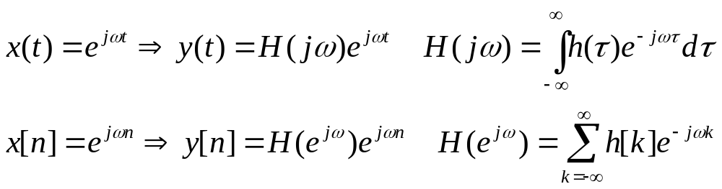
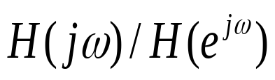
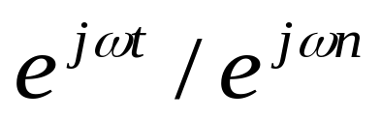
Chapter 3: Fourier Series
Why FS?
  When input is a complex-exponential signal
eigenvalue ----FT
eigenfunction

Slide 4
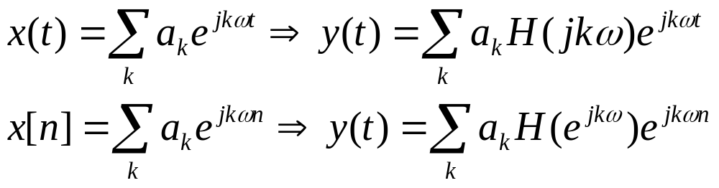
Chapter 3: Fourier Series
Why FS?
  Decompose input signal into sum of a series of complex-exponential signal
  Apply LTI Properties
  Easier to calculate output signal

Slide 5

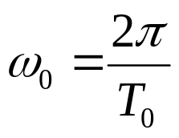
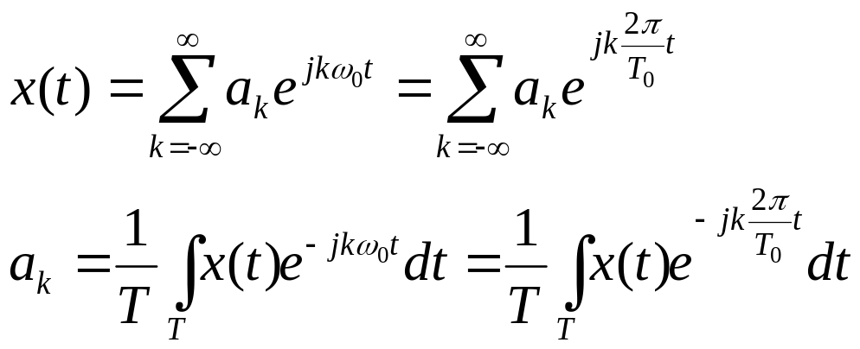

Definition of CTFS
For a periodic signal x(t)
  fundamental period
  fundamental radian frequency
  Fourier Series & Fourier Coefficients
Watch out for
k=0!
N th harmonic component

Slide 6
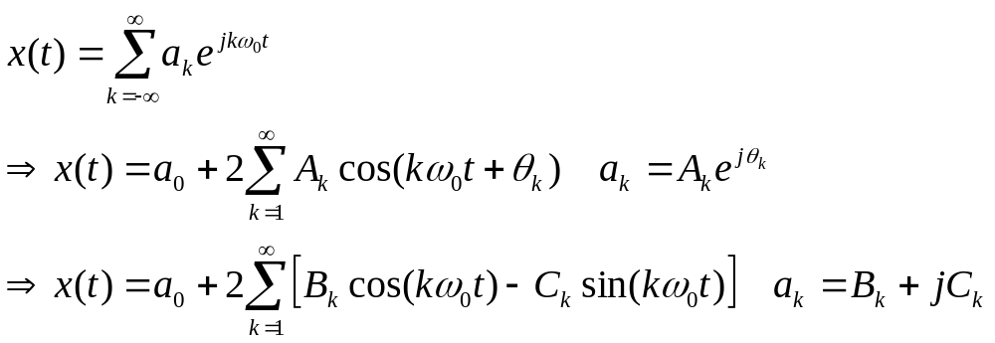
Trigonometric forms of CTFS
For real valued signal x(t)

Slide 7
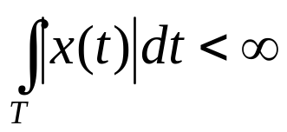
Dirichlet Conditions for CTFS
Conditions for a periodic signal to be representable by Fourier series
  x(t) is absolutely integrable
  finite number of maximum and minimum points in one period
  at most finite discontinuous poles in one period
Gibbs Phenomenon
  Lecture 7 Page 10-11

Slide 8
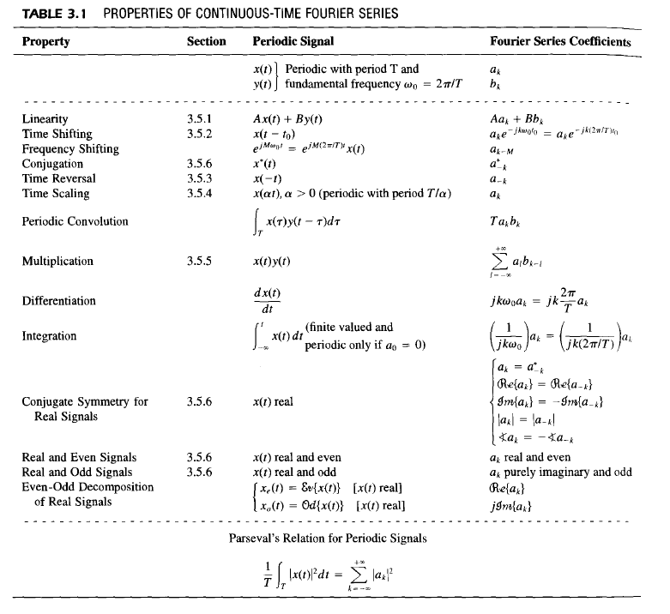
Properties of CTFS

Slide 9
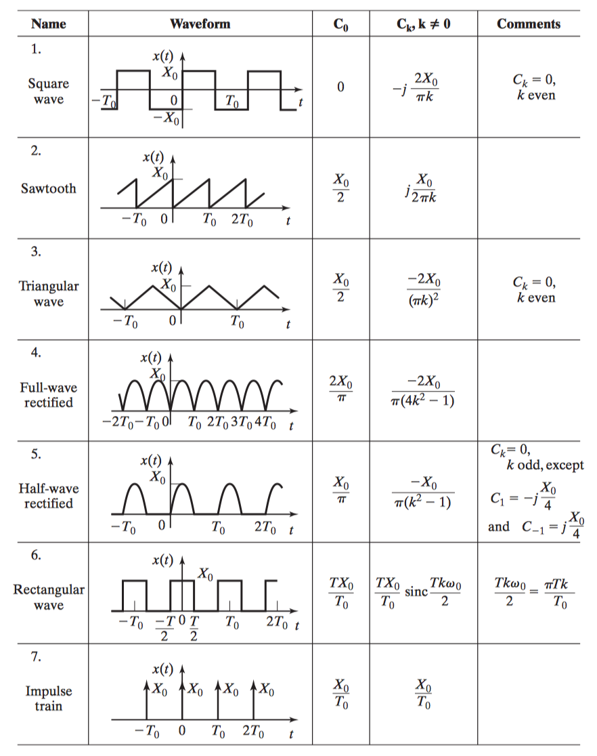
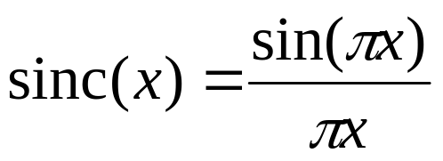
Common CTFS Pairs

Slide 10
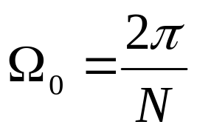
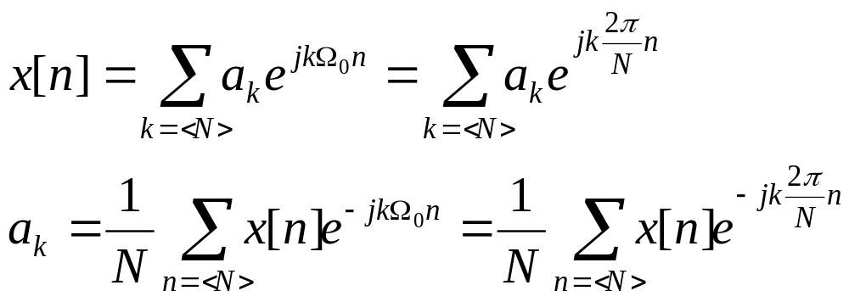
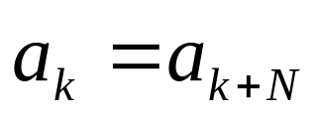
Definition of DTFS
For a periodic signal x[n]
  fundamental period N
  fundamental radian frequency
  Fourier Series & Fourier Coefficients
No Dirichlet
Conditions
for DTFS!
DTFC is also periodic with period N

Slide 11
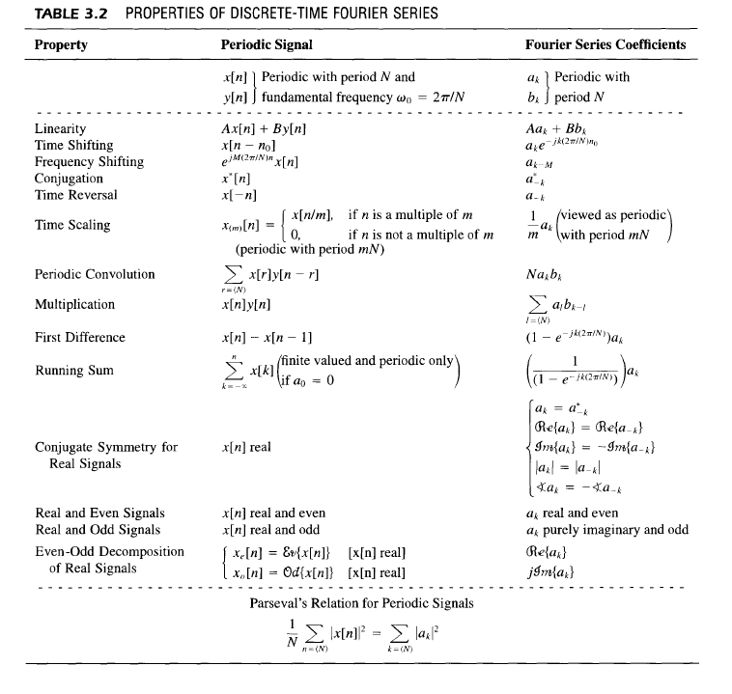
Properties of DTFS

Slide 12
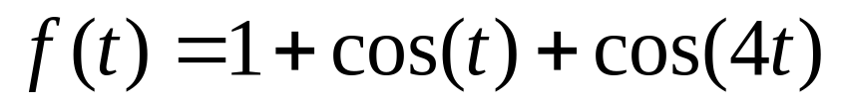
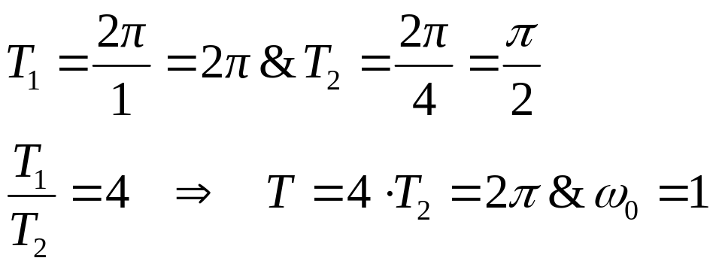
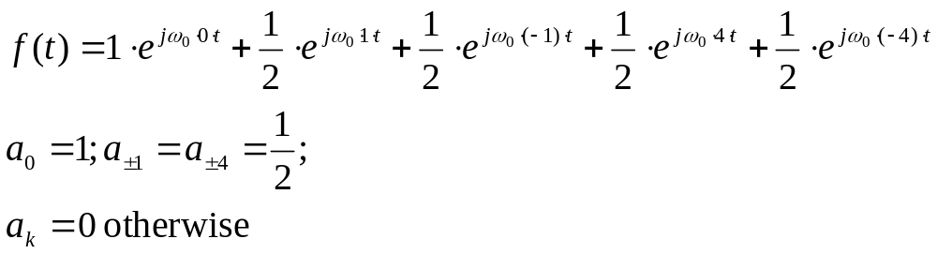
Calculate FS
Ex1:
Step 1: determine period
Step 2: calculate FC by Euler's formula

Slide 13
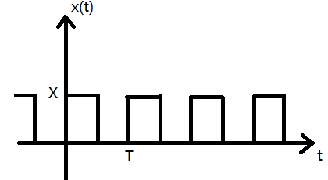
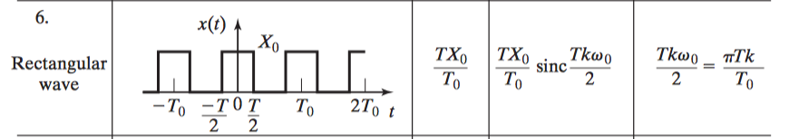
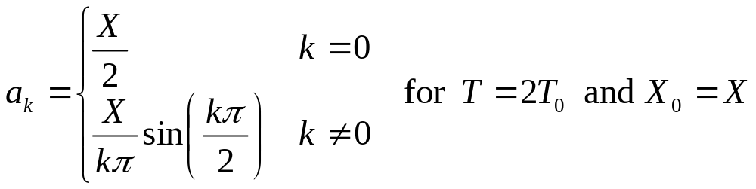
Calculate FS
Ex2:
Step 1: determine period T
Step 2: calculate FC by properies of FC and known FC pairs

Slide 14
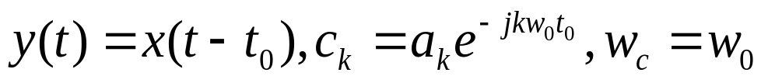
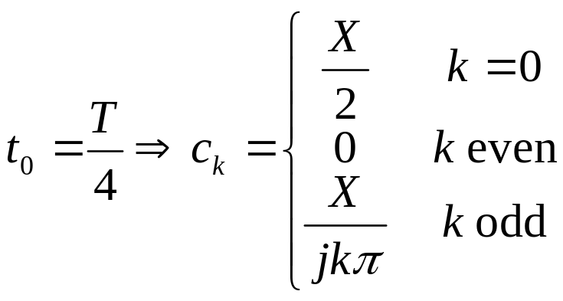
Calculate FS
Ex2:
Step 1: determine period
Step 2: calculate FC by properies of FC and known FC pairs
time shifting:

Slide 15

Calculate x(t) from FS
Ex3: HW3 Prob 3.23(d) T=4

Slide 16
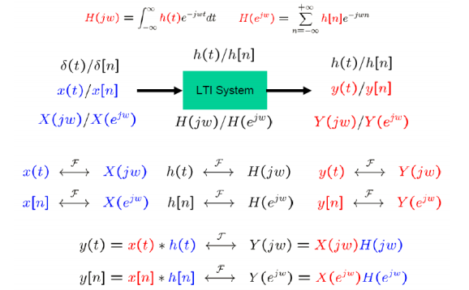
Chapter 6: Time & Frequency Characterization

Slide 17
Chapter 6: Time & Frequency Characterization
Why frequency domain?
  Convolution in time domain corresponds to multiplication in frequency domain

Slide 18
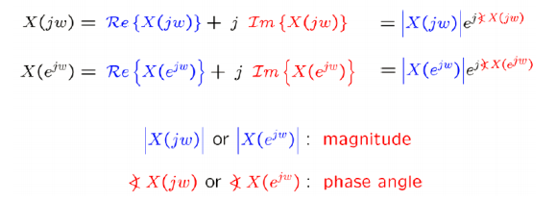
Magnitude-Phase Representation
For FT

Slide 19
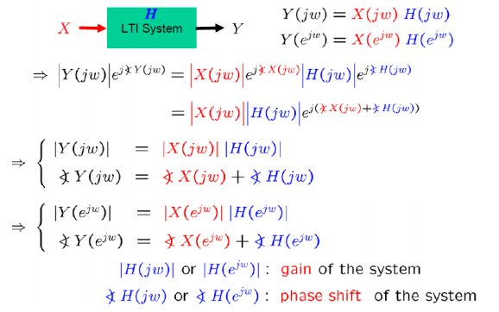
Magnitude-Phase Representation
For LTI System

Slide 20






Magnitude-Phase Representation
Bode Plot
frequency response | magnitude plot | phase plot
CT
DT

Slide 21
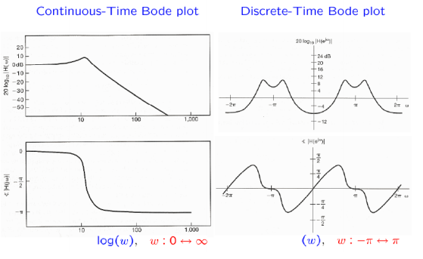
Magnitude-Phase Representation
Bode Plot

Slide 22
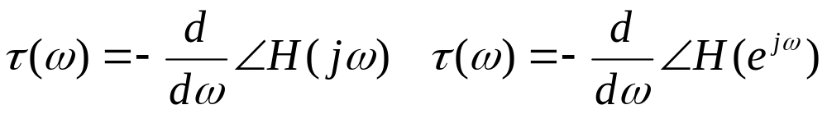
Magnitude-Phase Representation
System with Linear/nonlinear Phase
  phase shift at w is a linear function of w or not
  E.g. a system with generalized linear phase
Group Delay

Slide 23
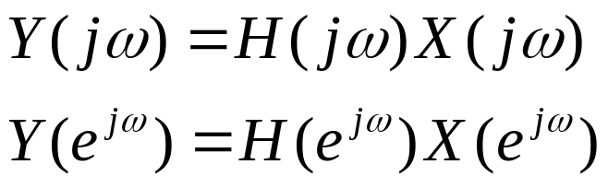
Filters
Some frequencies are attenuated/amplified/unchanged
Choose a certain portion of spectrum through H(jw)
such system called filter
  any LTI system can be considered as a filter

Slide 24
Ideal Filters
pass unchanged a certain band of frequencies
  passband
completely remove other frequencies
  stopband
Four types of filters
  Low-Pass, High-Pass, Band-Pass, Band-Stop

Slide 25
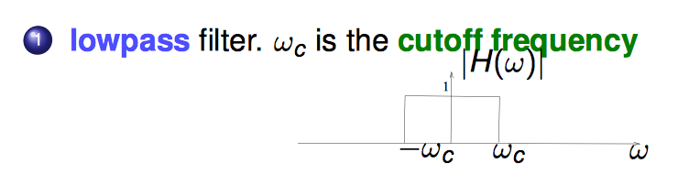
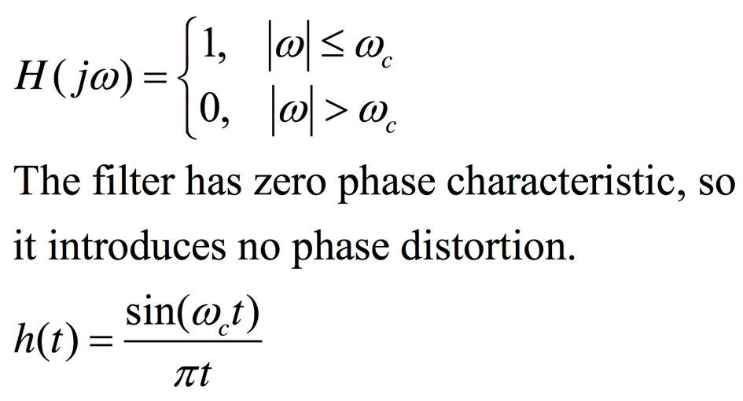
Ideal Filters
Ideal Low-Pass Filter

Slide 26
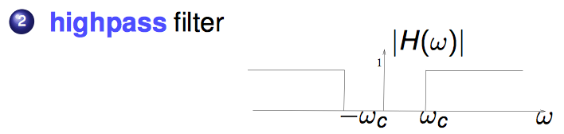
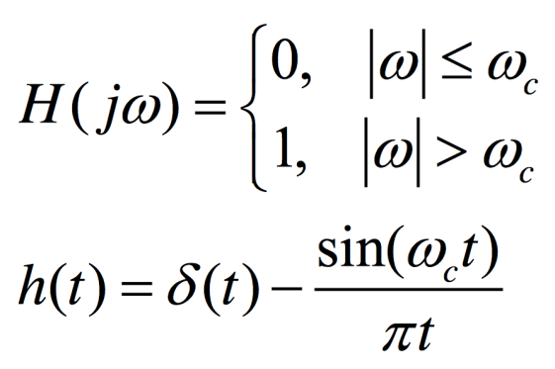
Ideal Filters
Ideal High-Pass Filter

Slide 27
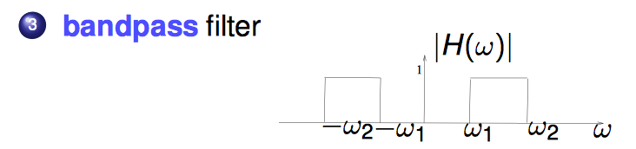
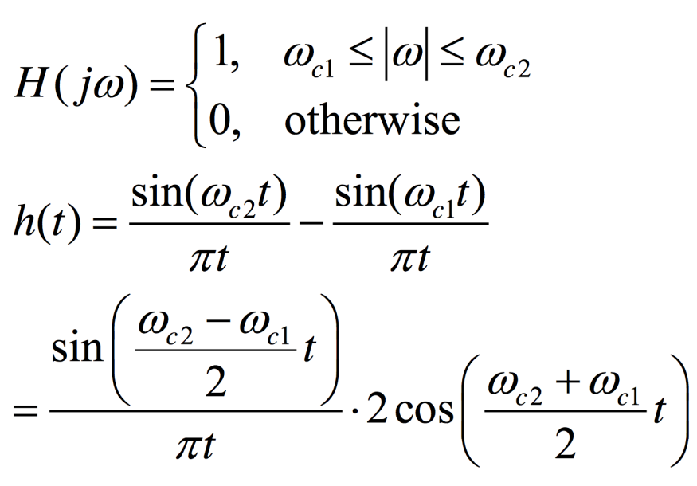
Ideal Filters
Ideal Band-Pass Filter

Slide 28
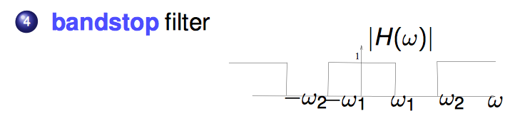
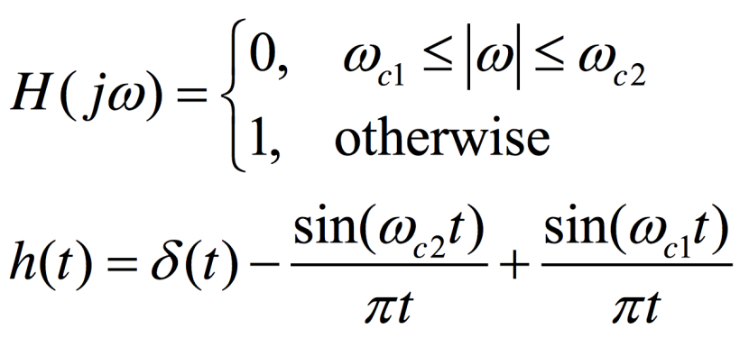
Ideal Filters
Ideal Band-Stop Filter

Slide 29
Non-Ideal Filters
Why non-ideal filters?
  Impulse response for ideal filters are not causal. Therefore it is almost impossible to implemented in practice
  If a signal is finite in frequency domain, it is infinite in time domain. Vice versa

Slide 30
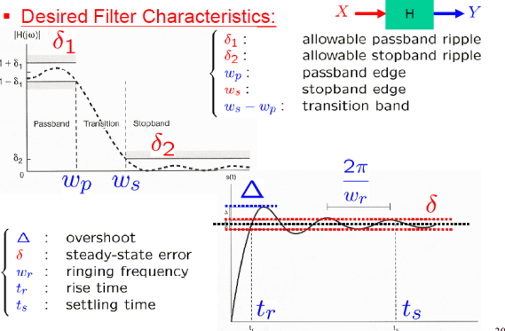
Non-Ideal Filters

Slide 31
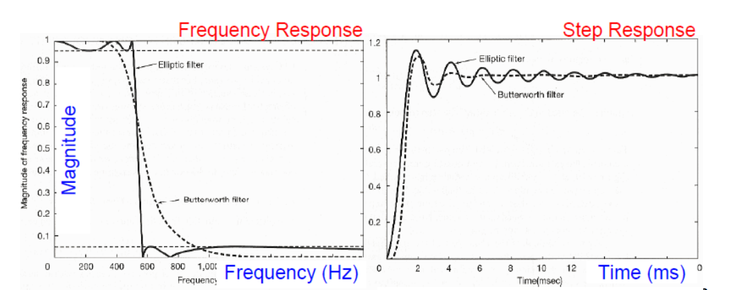
Non-Ideal Filters
Trade-offs between implementation and desired filter properties.
  E.g. Butterworth: smoother/less ripples Elliptic: sharper at cutoff freqeuncy

Slide 32
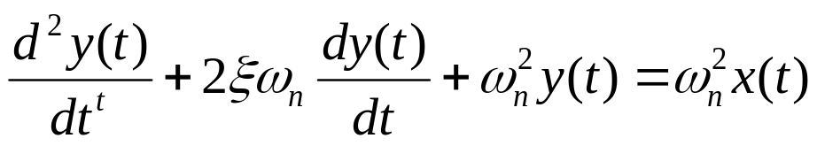
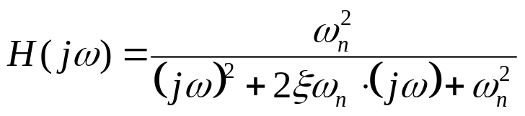
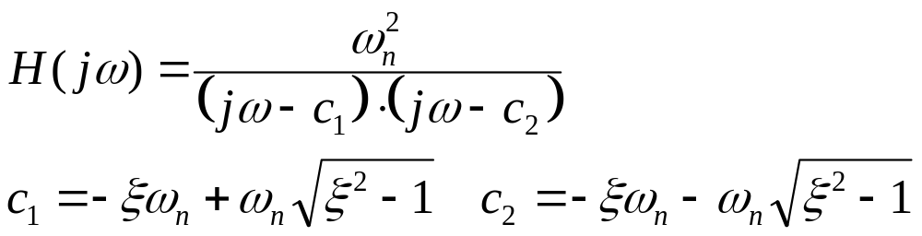
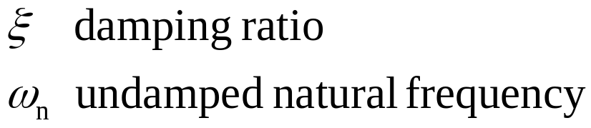
Second Order CT System
Differential Eqn
Frequency Response
Decompose H(jw)

Slide 33
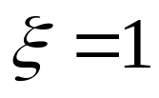
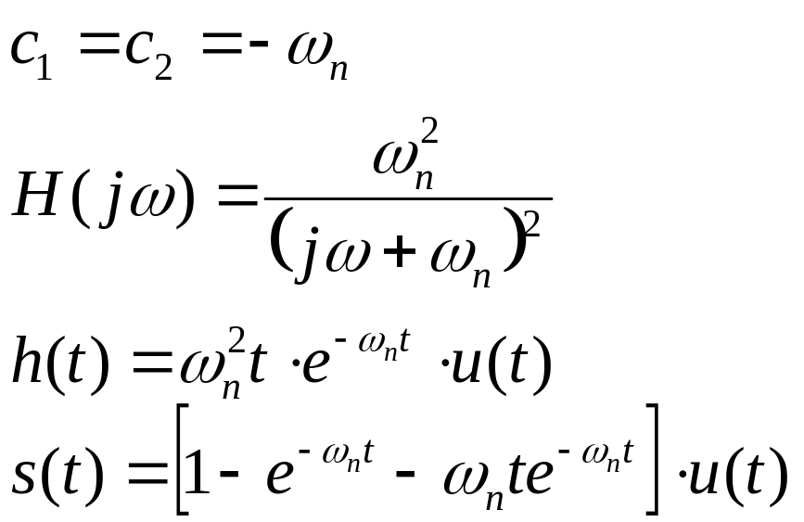
Second Order CT System
Critical Damped

Slide 34
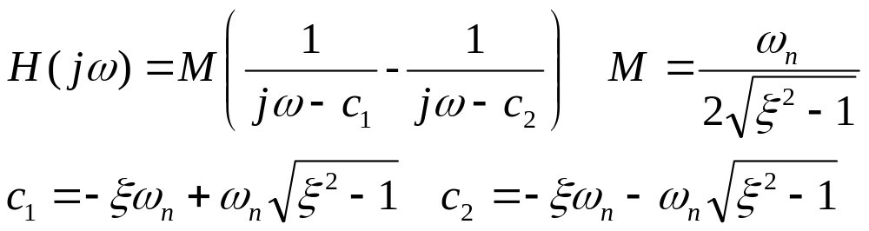
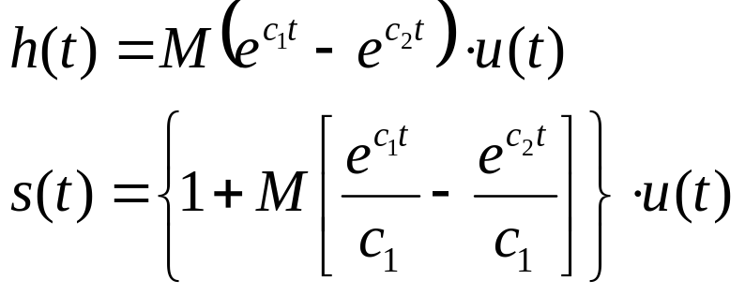



Second Order CT System
Under Damped

Slide 35



Second Order CT System
Over Damped

Slide 36

Second Order CT System
Step Response Plot

Slide 37

Second Order CT System
Bode Plot for H(jw)

Slide 38

Second Order CT System
Bode Plot for H(jw)

Slide 39


Second Order CT System
Bode Plot for H(jw)

Slide 40


More About Bode Plot

